Slide 1
Azure Data Lake & Factory Technical Deep Dive –Day 3
Sashank Pappu
Azure Data & AI Specialist
Shiva Priya
Azure Data Engineer

Slide 2


Sashank Pappu
Azure Data & AI Specialist.
Certified from MIT on ‘Advanced Analytics and Big Data Challenges’. Technology Enthusiast and Data Specialist. Certified Designer in Computer Vision
• Microsoft Certified Power BI Developer. • Microsoft Certified Azure Machine Learning Developer from Microsoft Virtual Academy • Certified on Practical Data Analytics with Microsoft Cortana Intelligence Suite.
9+ years of total experience as Data Specialist and Data Engineer.
Certifications
Experience
Currently working as Independent Consultant on Azure Data & AI and Enterprise Trainer on Azure Data Analytics , Cortana Intelligence Suite and Cognitive Sciences
Expert facilitator and corporate behavioral trainer with 5 years of experience in designing programs, content development , Data Analytics and Machine Learning.
Role
Training
Sri Nag Sashank
You can see me on – Sashankpappu.com

Slide 3
What we can learn together ??
Azure Data Ecosystem
Storage (Blob Vs Data Lake)
Data Lake Storage
Data Lake Analytics
Data Factory
URL : https://github.com/jumpstartninjatech/HeroSolutionsVLIT-Data

Slide 4
To Be More Precise
8:45-09:30 : Overview Data Ecosystem & Gen2
09:30-10:15 : Data Lake StorageGen2 Creation & Security
10:15-10:30 : BREAK !!!
10:30-11:30 : Data Lake Analytics Tables and Schemas
11:30-12 PM : ADF V2 Intro

Slide 5
Questionnaire
To be taken after each section .
Request you to ask the questions in Chat window .
Will respond to them after a logical break point in each topic.
This would make the workshop interesting and approachable .

Slide 6
Expected Outcome!
Azure Data Ecosystem – When to use what !
Architectural Standards & Best Practices in Azure .
Hands on Project ready confidence.
Tackling Real world challenges in Azure Data Platform
Real world use cases and architectures for huge clients.

Slide 7
Time to adapt is shrinking
A hundred years ago, the average lifespan of a company listed on the S&P 500 index was 67 years
In the 2020s…
75% of the S&P 500 will be new (not on the index today)
25% of the S&P 500 will
be ones on the index today
Source: BBC
Notes:
Compared to the past, what’s unique about the disruption happening today is its pace. During past revolutions, firms had many years, even decades, to adapt. Today, that is no longer the case. One indicator of just how fast the landscape is changing is the longevity of companies on the S&P 500, an index of leading US companies.
A hundred years ago, the average lifespan of a company listed on the S&P 500 was 67 years. Today, that average lifespan has decreased to just 15 years.
Experts predict that in the next decade, only 25% of the companies currently listed on the S&P 500 will remain there, and the other 75% will be replaced by new companies.
The bottom line is, today’s organizations must adapt quickly to change, using new technologies that fuel competitive advantage, or risk getting left behind.
-------------------------------------------
Statistics source:
BBC, 2012, quoting Richard Foster - http://www.bbc.com/news/business-16611040
"The average lifespan of a company listed in the S&P 500 index of leading US companies has decreased by more than 50 years in the last century, from 67 years in the 1920s to just 15 years today, according to Professor Richard Foster from Yale University. Professor Foster estimates that by 2020, more than three-quarters of the S&P 500 will be companies that we have not heard of yet."

Slide 8
Experts predict that in the next decade, only 25% of the companies currently listed on the S&P 500 will remain there, and the other 75% will be replaced by new companies.

Slide 9
Approach of Data is Changing !!!

Slide 10
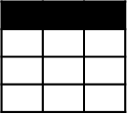
Evolving Approaches to Analytics EDWs to Data Lakes
Extract
Transform
Load
OLTP
…
EDW
(SQL Svr, Teradata, etc)
Original Data
ETL Tool
(SSIS, etc)
Transformed Data
BI Tools
ERP
LOB
Data Marts
Data Lake(s)
Dashboards
Apps

Slide 11
Evolving Approaches to Analytics EDWs to Data Lakes
Extract
Transform
Load
OLTP
…
EDW
(SQL Svr, Teradata, etc)
Original Data
ETL Tool
(SSIS, etc)
Transformed Data
BI Tools
ERP
LOB
Data Marts
Data Lake(s)
Dashboards
Devices
Social
Ingest (EL)
Apps
Sensors
Original Data
Web

Slide 12
Evolving Approaches to Analytics EDWs to Data Lakes
Extract
Transform
Load
OLTP
…
EDW
(SQL Svr, Teradata, etc)
Original Data
ETL Tool
(SSIS, etc)
Transformed Data
BI Tools
ERP
LOB
Data Marts
Data Lake(s)
Dashboards
Devices
Social
Ingest (EL)
Scale-out Storage & Compute
(HDFS, Blob Storage, etc)
Apps
Sensors
Original Data
Web
Streaming data
Transform & Load

Slide 13
Evolving Approaches to Analytics EDWs to Data Lakes
Extract
Transform
Load
OLTP
…
EDW
(SQL Svr, Teradata, etc)
Original Data
ETL Tool
(SSIS, etc)
Transformed Data
BI Tools
ERP
LOB
Data Marts
Data Lake(s)
Dashboards
Devices
Social
Ingest (EL)
Scale-out Storage & Compute
(HDFS, Blob Storage, etc)
Apps
Sensors
Original Data
Web
Streaming data
Transform & Load

Slide 14
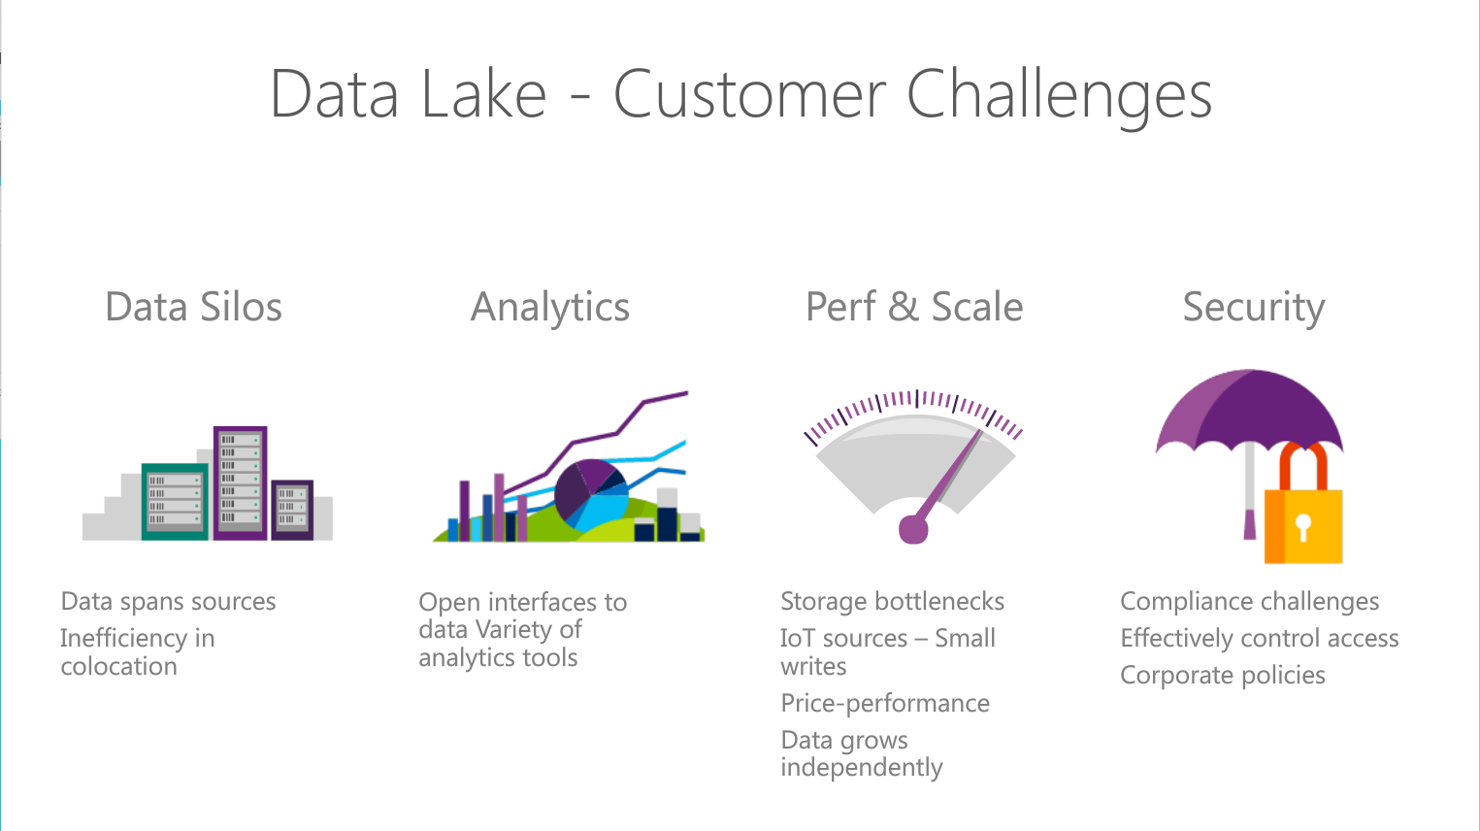
Notes:
Objetive – explain what are the Customer challeges that Azure Data Lake solution addresses
Read through the points.

Slide 15
The Intelligent Lake
Petabytes of Data + Intelligence
Data Lake Store
No-limits data Lake
Petabyte-sized files
Trillions of objects
Scalable I/O for parallel analytics
Enterprise-grade Security
Data Lake Analytics
Analytics job service
Scale instantly
Scale per job
Infused with Artificial Intelligence

Slide 16
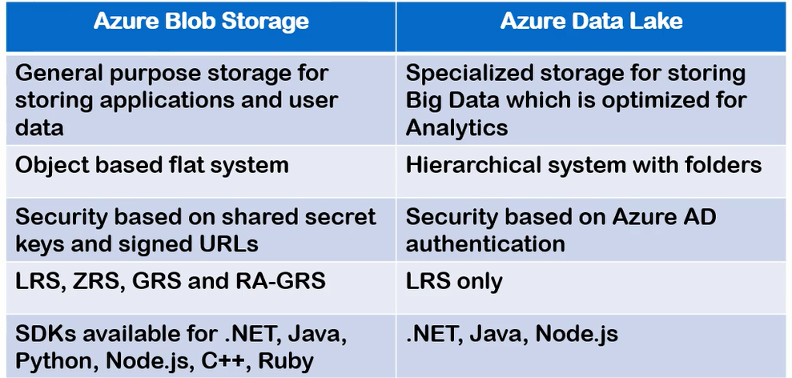
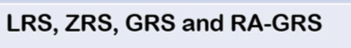
Azure Data Lake Storage Gen 1 Vs BLOB

Slide 17
ADLS Gen1 + BLOB = ADLS Gen 2
Use | Data Lake Store | Blob Storage | Data Lake Gen 2
Hot/Cold Storage Tiers | No | Yes | Yes
Redundant Storage | No | Yes | Yes
AD Security | Yes | No | Yes
HDFS Compatible | Yes | No | Yes

Slide 18
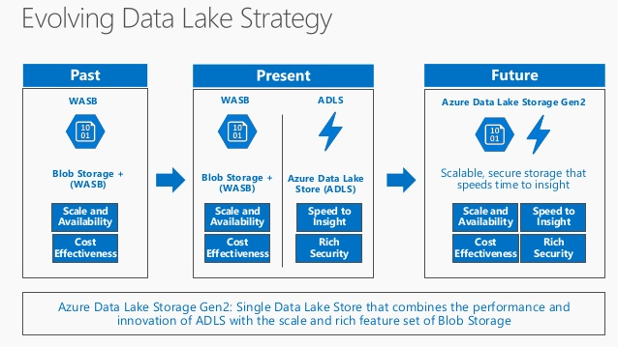
ADLS Gen1 + BLOB = ADLS Gen2

Slide 19
Azure Data Lake Use Cases

Slide 20
Retail Scenario Implementation
ON-PREMISES
CLOUD
CONSUMPTION
Massive Archive
Web Portals
Initial one time import
“Landing Zone”
Data Lake Store
DW (many instances)
On-Prem HDFS
Mobile Apps
via AzCopy
Curated Data
Data is portioned into multiple SQL DWs (one per data consumer. Several hundred consumers)
Power BI
Incremental
updates
Experimentation
Machine Learning
A/B testing at scale. Drive changes based on actual
Customer behavior
Do ML at Scale (Customer Segmentation & Fraud Detection)
Active Incoming Data
Jupyter
Notebooks
Notes:
Discuss how the previous scenario can fir into a concrete scenario for retail sector .
Here we use ADLS as store to where dat is uploaded from on-premise HDFS cluster and it analysed to extract additional insight using machine learning techniques
To do fraud prediction or customer segmentation. The data can then be suploaded to SQL data warehose to which various clients connect to conume data.

Slide 21
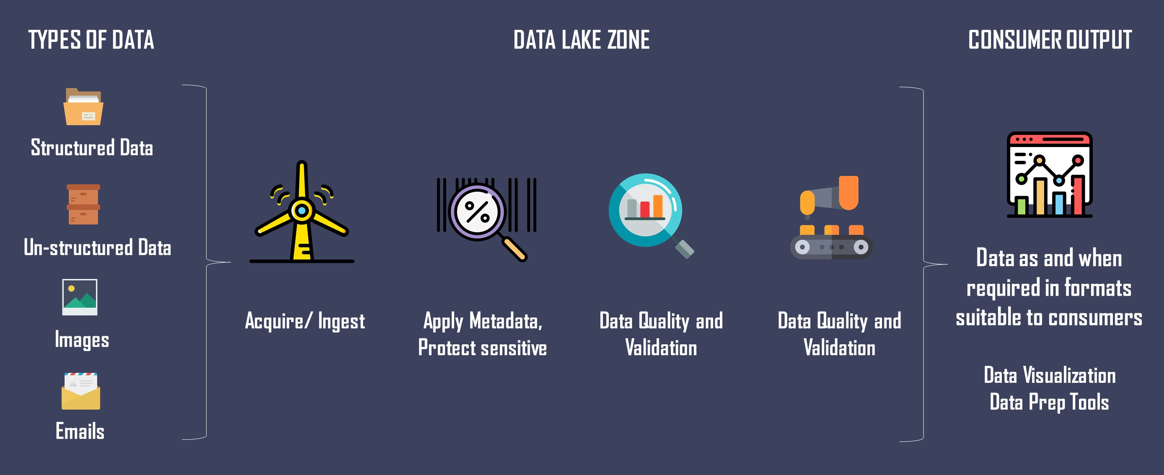
Zones in

Slide 22
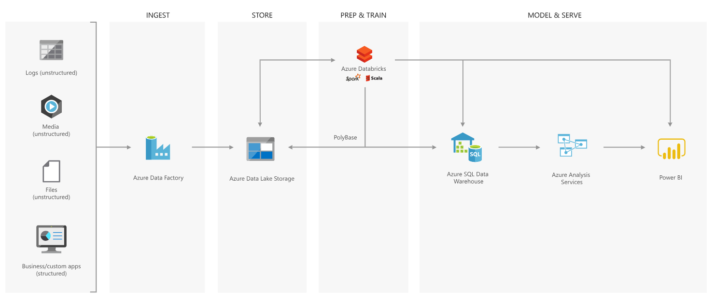
Best Practices – Modern Data Warehouse

Slide 23
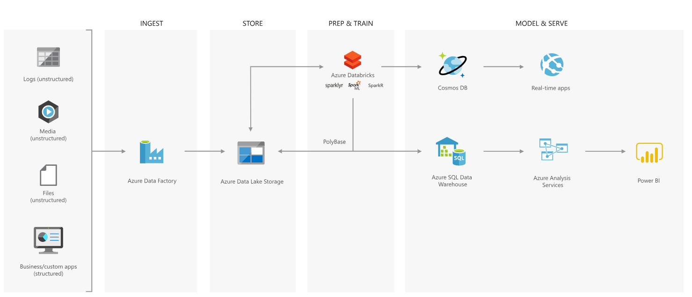
Advanced Analytics Approach

Slide 24

Azure Data Lake Store
Notes:
Lets have a look at the Data Lake Store service in more detail

Slide 25
Introducing Azure Data Lake Store
A hyper-scale repository for big data analytics workloads
Store ANY DATA in its native format
HADOOP FILE SYSTEM (HDFS) for the cloud
ENTERPRISE GRADE
No limits to SCALE
Optimized for analytic workload PERFORMANCE
Notes:
Objective: This is the introductory slide for Azure Data Lake Store.
Talking Points:
Microsoft describes Data Lake Store as a “hyper-scale repository for big data analytic workloads.” Azure Data Lake Store is an enterprise wide hyper-scale repository for big data analytic workloads.
Any Data - This lets you store all of your data and analyze them in their native format.
Hadoop File System - Azure Data Lake Store is a Hadoop file system which is compatible with HDFS and works with the Hadoop ecosystem.
Enterprise Grade - Azure Data Lake Store provides industry standard availability and reliability and also provides enterprise grade security for all data.
Scale - Azure Data Lake Store provides unlimited storage and is suitable for storing a variety of data.
Performance - Azure Data Lake Store is built for running large scale analytic systems that require massive throughput to query and analyze large amounts of data.

Slide 26

The Data Lake Approach
Ingest all data regardless of requirements
Store all data
in native format without schema definition
Do analysis
Using analytic engines like Hadoop and ADLA
Devices
Social
Batch queries
LOB applications
Video
Devices
Interactive queries
LOB applications
Social
Sensors
Real-time analytics
Web
Sensors
Video
Machine Learning
Relational
Web
Clickstream
Data warehouse
Relational
Clickstream
Notes:
Motivation – explain that ALS Store is Load Transform and Extract rather than ETL. You essentially postpone the schema definition until the extraction time.
A data lake is an enterprise wide repository of every type of data collected in a single place. Data of all types can be arbitrarily stored in the data lake prior to any formal definition of requirements or schema for the purposes of operational and exploratory analytics. Advanced analytics can be done using Hadoop, Machine Learning tools, or act as a lower cost data preparation location prior to moving curated data into a data warehouse. In these cases, customers would load data into the data lake prior to defining any transformation logic.
This is bottom up because data is collected first and the data itself gives you the insight and helps derive conclusions or predictive models.

Slide 27


Any data
Devices
Video
Unstructured
Semi-structured
Structured
Clickstream
Web
Social
Sensors
Relational
LOB applications
Notes:
Objective: This slide is about how Azure Data Lake Store can store any type of data.
Talking Points:
Data Lake Store allows you to store relational and non-relational data. It also does not require a schema to be defined before the data is loaded. This data can be from devices, videos, and web applications. Here data can be further classified into:
Unstructured Data - This data either does not have predefined data model or is not organized. It is typically text-heavy and may contain data like dates, numbers, and facts.
Semi-Structured Data - These are self-describing structures that do not conform with the formal structure of data models associated with the relational database or other forms of data tables.
Structured Data - This data resides in a fixed field within a record file. It includes data contained in relational databases and spreadsheets.

Slide 28



Durable and highly available
Automatically replicates your data
Three copies within a single region
Highly available
Notes:
Objective: This slide shows how data is durable and highly available with Azure Data Lake Store.
Talking Points:
One of the prior requirements is the availability of data at any place and any time. ADL Store provides industry standard availability and reliability in the following ways:
The ADL Store Automatically replicates the data to help against unexpected hardware failures and make sure it is available when you need it.
Azure Data Lake automatically replicates your data to help guard against unexpected hardware failures and make sure it's available when you need it. We keep three copies within a single region.

Slide 29
Unlimited storage
PB
TB
GB
Unlimited account sizes
Individual file sizes from gigabytes to petabytes
No limits to scale
TB
PB
Notes:
Objective: This slide shows how Azure Data Lake supports unlimited storage.
Talking Points:
Azure Data Lake Store provides unlimited storage and is suitable for storing a variety of data for analytics.
Azure Data Lake has unbounded scale with no limits to how much data can be stored in a single account.
While other cloud storage offerings might restrict individual file sizes to 5 terabytes, Azure Data Lake can store very large files in the petabytes (200x larger) with immediate read/write access and high throughput useful for scenarios like high resolution videos, scientific, medical, large backup data, event streams, web logs, IoT scenarios, and more.
Everything can be collected and stored in Azure Data Lake without restriction or prior understanding of business requirements.

Slide 30
Hands on – Data Lake Gen2
Creation of Data Lake Gen2 Account

Slide 31
Security Considerations

Slide 32
Data Protection
Protect the data at rest
Protect the data in transit
Support browser cross-domain access
Control who can access data
Audit storage access

Slide 33
Understand storage account keys
Data is generated or consumed by custom applications
The applications are written in various languages.
Create authorized apps in Active Directory to control access to the data in blobs

Slide 34
Understand shared access signatures
You shouldn't share storage account keys with external third-party applications
For untrusted clients, use a shared access signature (SAS)
Types of shared access signatures
service-level shared access signature
account-level shared access signature

Slide 35
Control network access to your storage account
Storage accounts accept connections from clients on any network
To limit access to selected networks, you must first change the default action.
You can restrict access to specific IP addresses, ranges, or virtual networks

Slide 36
Understand Advanced Threat Protection for Azure Storage
Often any protection only shows you that an intrusion has already occurred.
What you really want is a way to be notified when suspicious activity is happening
Advanced Threat Protection, detects anomalies in account activity
It then notifies you of potentially harmful attempts to access your account.

Slide 37
Azure Data Lake Analytics
2016/05/17

Slide 38
Quick Recap

Slide 39
ADL VS SQL DB
Azure Data Lake
ADL Analytics + ADL Store
SQL DB
SQL Query + DB Storage

Slide 40
Familiar syntax to millions of SQL & .NET developers
Unifies declarative nature of SQL with the imperative power of C#
Unifies structured, semi-structured and unstructured data
Distributed query support over all data
U-SQL
A new language for Big Data

Slide 41
History

Slide 42
History
Bing needed to…
Understand user behavior
And do it…
At massive scale
With agility and speed
At low cost
So they built …
Cosmos
Cosmos
Batch Jobs
Interactive
Machine Learning
Streaming
Thousands of Developers

Slide 43
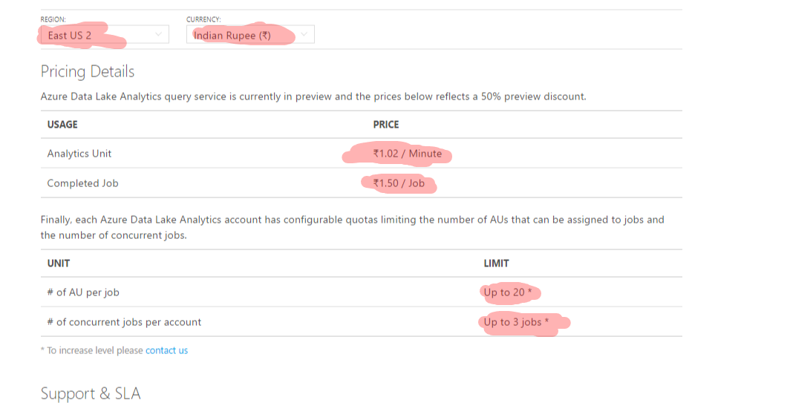
Pricing

Slide 44
Azure Data Lake Analytics (ADLA) Demo

Slide 45
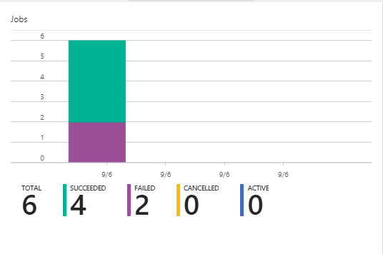

Slide 46
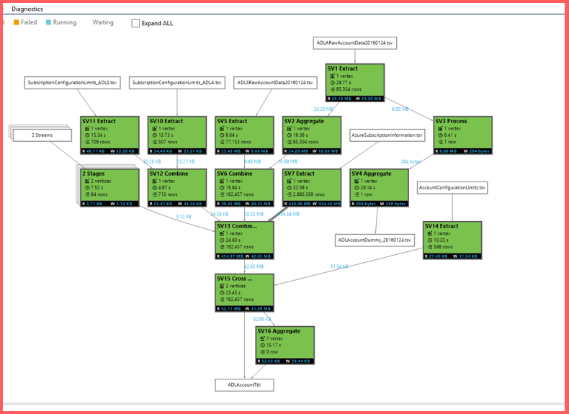

Slide 47
Job Scheduling States, Queue, Priority

Slide 48
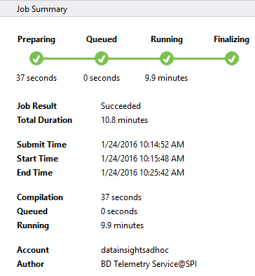
Job Status

Slide 49
UX
Job State
Preparing
New
The script is being compiled by the Compiler Service
Compiling
All jobs enter the queue.
Queued
Queued
Are there enough ADLAUs to start the job?
Scheduling
Starting
If yes, then allocate those ADLAUs for the job
Running
Running
The U-SQL runtime is now executing the code on 1 or more ADLAUs or finalizing the outputs
Finalizing
Ended
(Succeeded, Failed, Cancelled)
Ended
The job has concluded.

Slide 50
U-SQL Job Compilation

Slide 51
U-SQL Compilation Process
U-SQL Metadata Service
Compilation output (in job folder)
C#
managed dll
C++
Unmanaged dll
Compiler & Optimizer
Algebra
Other files
(system files, deployed resources)
Deployed to Vertices

Slide 52

The Job Folder
Inside the Default ADL Store:
/system/jobservice/jobs/Usql/YYYY/MM/DD/hh/mm/JOBID
/system/jobservice/jobs/Usql/2016/01/20/00/00/17972fc2-4737-48f7-81fb-49af9a784f64

Slide 53
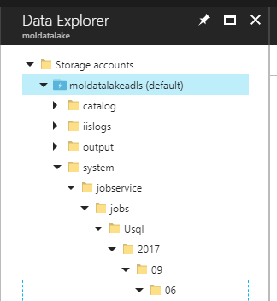
Job folder Structure
/system/jobservice/jobs/Usql/YYYY/MM/DD/hh/mm/JOBID

Slide 54
ADLAUs
Azure
Data
Lake
Analytics
Unit
Parallelism N = N ADLAUs
1 ADLAU ~=
A VM with 2 cores and 6 GB of memory

Slide 55
Vertex Execution

Slide 56
Store Basics
A VERY BIG FILE
Files are split apart into Extents.
Extents can be up to 250MB in size.
For availability and reliability, extents are replicated (3 copies).
Enables parallelized read
1
2
3
4
5
1
2
3
4
5
1
2
3
4
5
1
2
3
4
5

Slide 57
Parallel writing
Front-end machines for a web service
Log files
Simultaneous
uploads
Azure Data lake

Slide 58
As file size increases, more opportunities for parallelism
Extent
Vertex
Extent
Vertex
Extent
Vertex
Extent
Vertex

Slide 59
ADLA File Management
Hands on

Slide 60
The importance of partitioning input data

Slide 61
Search engine clicks data set
A log of how many clicks a certain domain got within a session
SessionID Domain Clicks
3 cnn.com 9
1 whitehouse.gov 14
2 facebook.com 8
3 reddit.com 78
2 microsoft.com 1
1 facebook.com 5
3 microsoft.com 11

Slide 62
Data Partitioning Compared
Extent 1
Extent 2
Extent 3
Extent 1
Extent 2
Extent 3
FB
FB
FB
FB
WH
CNN
WH
CNN
WH
CNN
WH
FB
WH
WH
CNN
FB
CNN
CNN
File:
Keys (Domain) are scattered across the extents
U-SQL Table partitioned on Domain
The keys are now “close together” also the index tells U-SQL exactly which extents contain the key

Slide 63
Click Data :
CREATE TABLE SampleDBTutorials.dbo.ClickData ( SessionId int, Domain string, Clinks int, INDEX idx1 //Name of index CLUSTERED (Domain ASC) //Column to cluster by ); INSERT INTO SampleDBTutorials.dbo.ClickData SELECT * FROM @clickdata;

Slide 64
Find all the rows for cnn.com
// Using a File
@ClickData =
SELECT
Session int,
Domain string,
Clicks int
FROM “/clickdata.tsv”
USING Extractors.Tsv();
@rows = SELECT *
FROM @ClickData WHERE Domain == “cnn.com”;
OUTPUT @rows
TO “/output.tsv”
USING Outputters.tsv();
// Using a U-SQL Table partitioned by Domain
@ClickData =
SELECT *
FROM MyDB.dbo.ClickData;
@rows = SELECT *
FROM @ClickData WHERE Domain == “cnn.com”;
OUTPUT @rows
TO “/output.tsv”
USING Outputters.tsv();

Slide 65
File
U-SQL Table Partitioned by Domain
CNN,
FB,
WH
CNN,
FB,
WH
CNN,
FB,
WH
FB
WH
CNN
EXTENT 1
EXTENT 2
EXTENT 3
EXTENT 1
EXTENT 2
EXTENT 3
Read
Read
Read
Read
Filter
Filter
Filter
Filter
Write
Write
Write
Write
Because “CNN” could be anywhere, all extents must be read.
Thanks to “Partition Elimination” and the U-SQL Table, the job only reads from the extent that is known to have the relevant key

Slide 66
How many clicks per domain?
@rows = SELECT
Domain,
SUM(Clicks) AS TotalClicks FROM @ClickData GROUP BY Domain;

Slide 67
File
U-SQL Table Partitioned by Domain
CNN,
FB,
WH
CNN,
FB,
WH
CNN,
FB,
WH
FB
WH
CNN
EXTENT 1
EXTENT 2
EXTENT 3
Read
Read
Read
EXTENT 1
EXTENT 2
EXTENT 3
Partial Agg
Partial Agg
Partial Agg
Read
Read
Read
Partition
Partition
Partition
Full Agg
Full Agg
Full Agg
Expensive!
Write
Write
Write
Full Agg
Full Agg
Full Agg
Write
Write
Write

Slide 68
Hands on Lab -ADLA
Creating Data Catalog Objects

Slide 69
How about a Break !!!

Slide 70
Data Factory

Slide 71
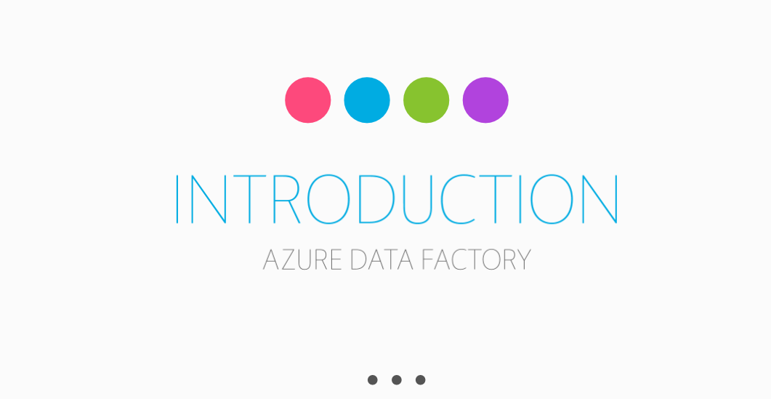

Slide 72
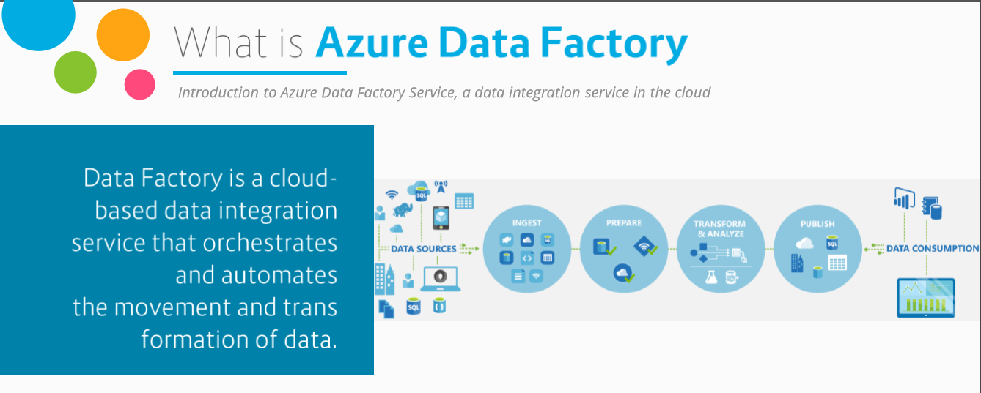
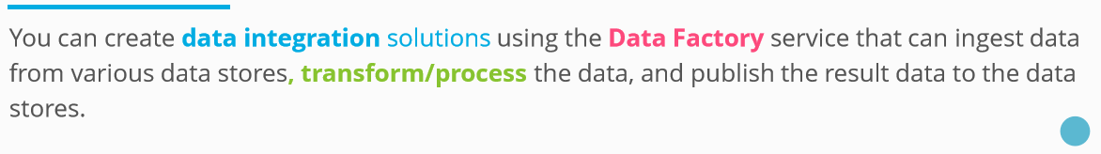

Slide 73
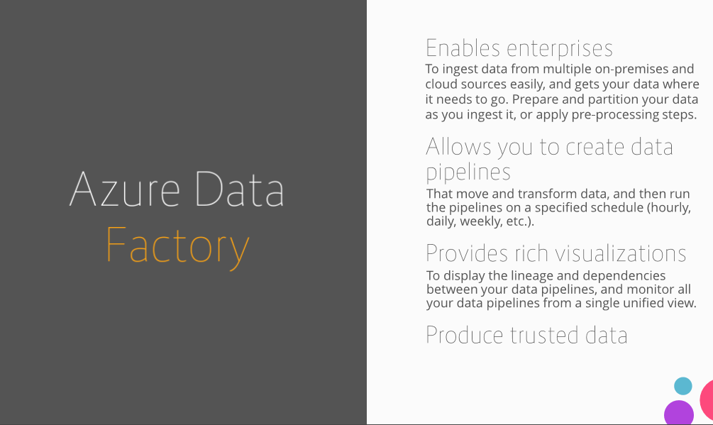

Slide 74
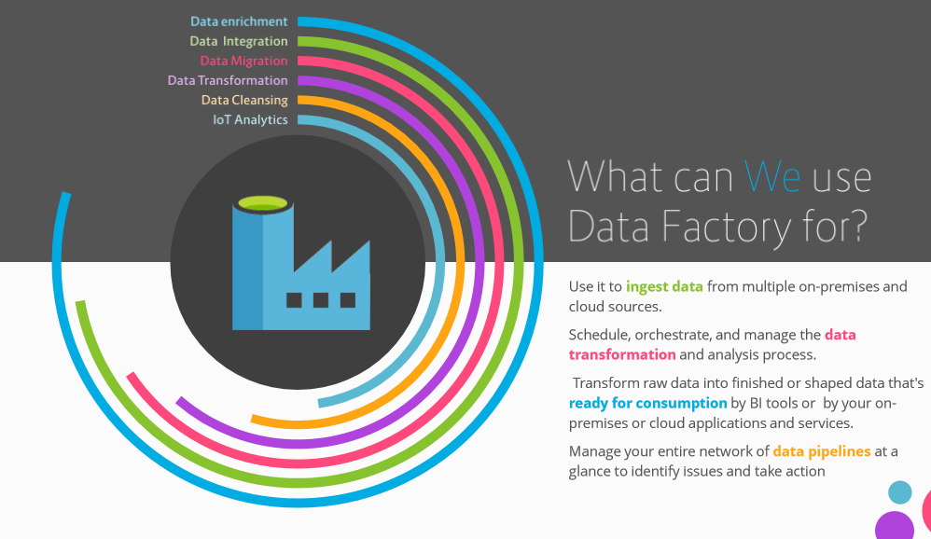

Slide 75
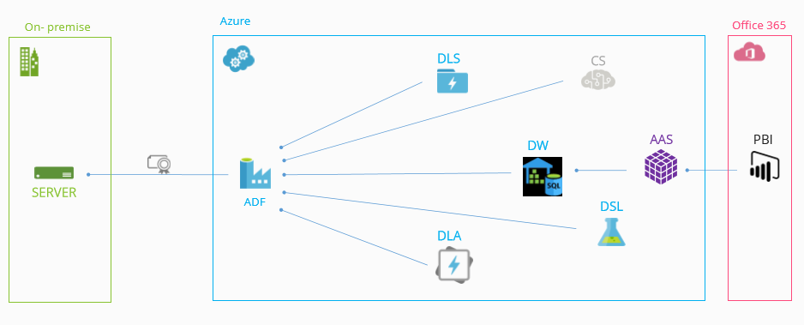
Data Sources Usage

Slide 76
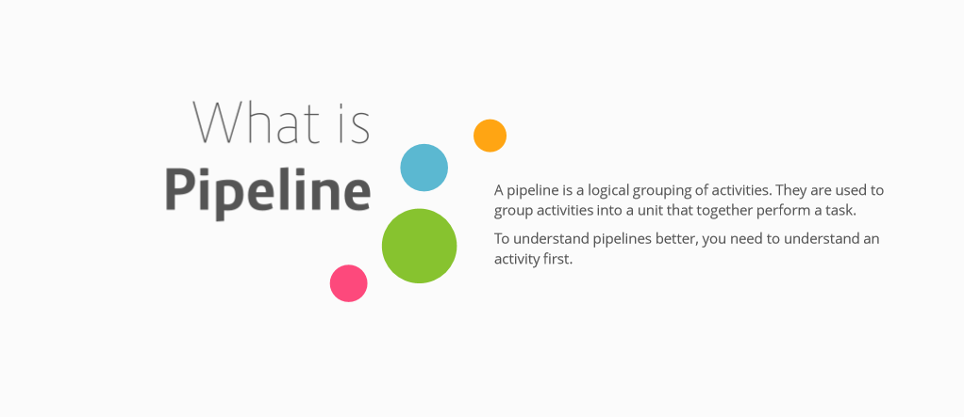

Slide 77
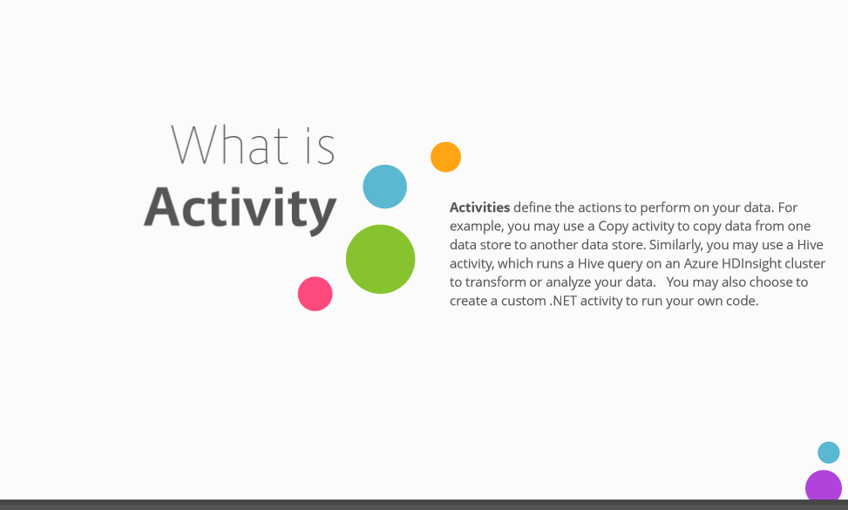

Slide 78
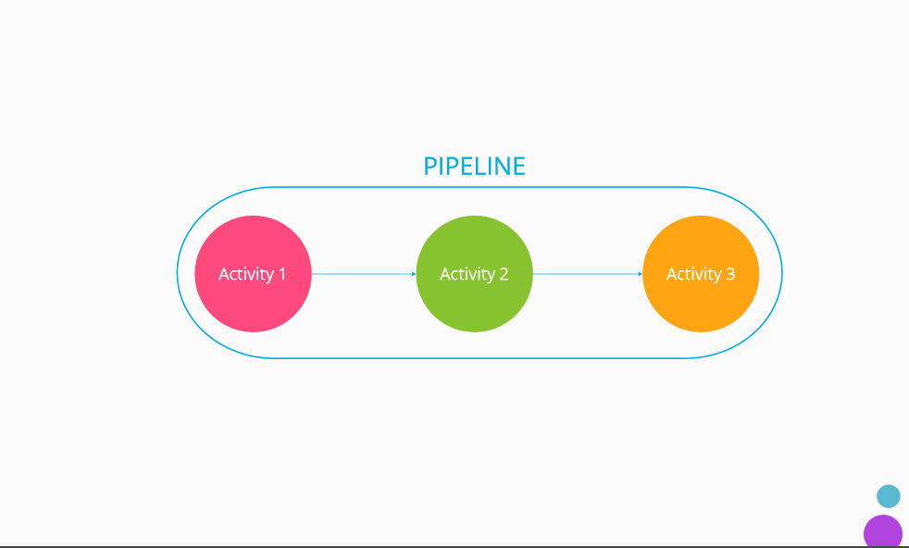

Slide 79
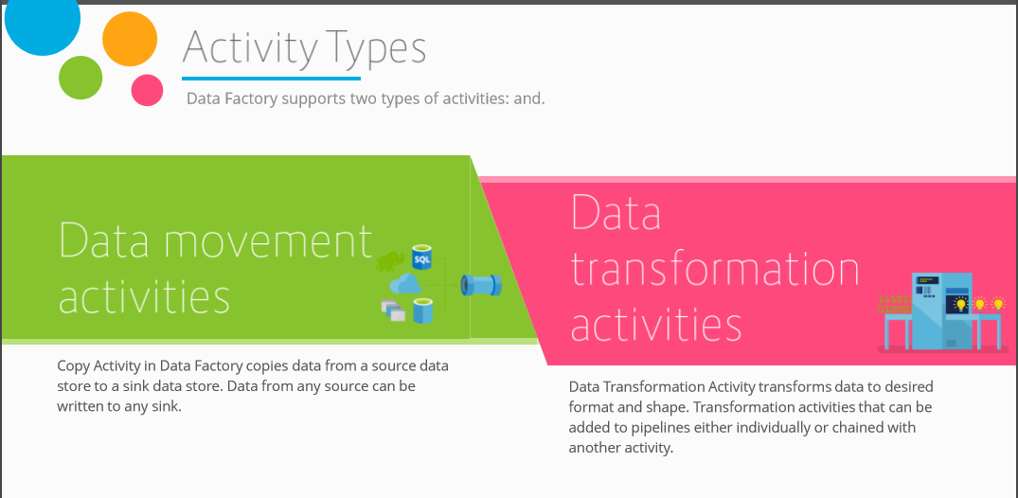

Slide 80
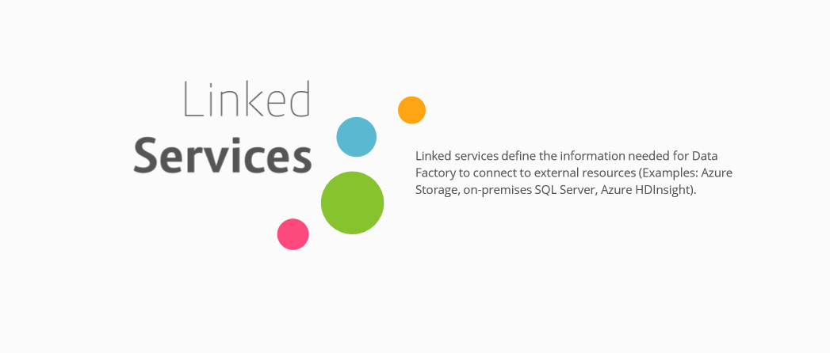

Slide 81
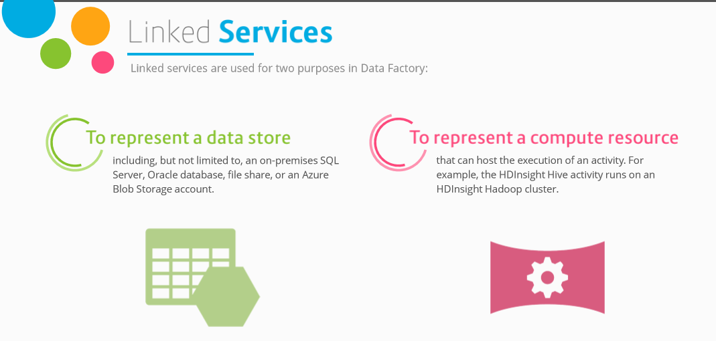

Slide 82
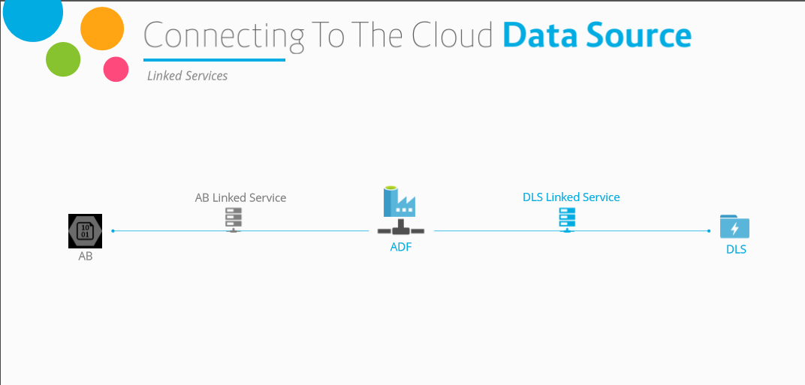

Slide 83
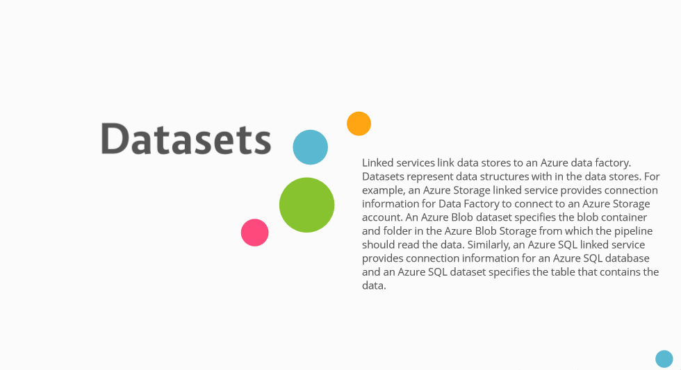

Slide 84
2. Create the Data Factory
Portal, PowerShell and Visual Studio
Notes:
Setting Up: https://azure.microsoft.com/en-us/documentation/articles/data-factory-build-your-first-pipeline/

Slide 85
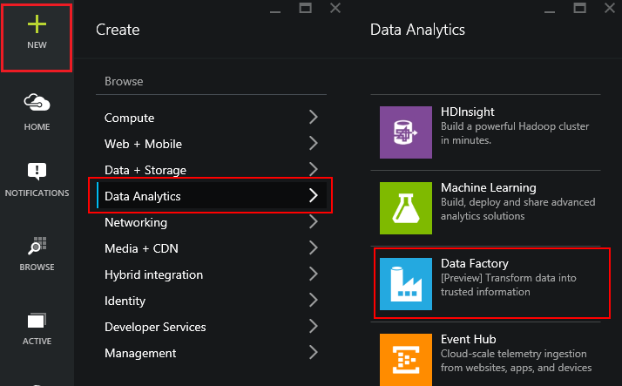
Using the Portal
Use in Non-MS Clients
Use for Exploration
Use when teaching or in a Demo
Notes:
LAB 2:
Open the file StudentWorkbook.txt
Complete Lab 2
Overview: https://azure.microsoft.com/en-us/documentation/articles/data-factory-build-your-first-pipeline/
Using the Portal: https://azure.microsoft.com/en-us/documentation/articles/data-factory-build-your-first-pipeline-using-editor/

Slide 86
ADF V2

Slide 87
Concepts
Data Source
Dataset
Pipeline
is a grouping of logically related activities. It is used to group activities into a unit that performs a task
Concepts
Activities define the actions to perform on your data. Each activity takes zero or more datasets as inputs and produces one or more datasets as output.
Activity
Linked services
computing environment
Notes:
We have four main concepts.
First. Dataset is data source
Second. Activity. It’s actions to perform on your data
Third. Pipeline. It’s a grouping of logically related activities
And finally. Linked services are computing environment or external resource. For example It’ s Hive, Machine Learning, stored procedure
Let’s look at these concepts in more detail

Slide 88
Expressions & Parameters
String functions – concat, substring, replace, indexof etc.
Collection functions – length, union, first, last etc.
Logic functions – equals, less than, greater than, and, or, not etc.
Conversation functions – coalesce, xpath, array, int, string, json etc.
Math functions – add, sub, div, mod, min, max etc.
Date functions – utcnow, addminutes, addhours, format etc.

Slide 89
System variables
Pipeline scope
Trigger scope
Variable Name
@pipeline().DataFactory
@pipeline().Pipeline
@pipeline().RunId
@pipeline().TriggerType
@pipeline().TriggerId
@pipeline().TriggerName
@pipeline().TriggerTime
Variable Name
trigger().scheduledTime
trigger().startTime

Slide 90
Trigger

Slide 91
Type of triggers
Manual execution
Schedule trigger: A trigger that invokes a pipeline on a wall-clock schedule.
Tumbling window trigger: A trigger that operates on a periodic interval, while also retaining state.

Slide 92
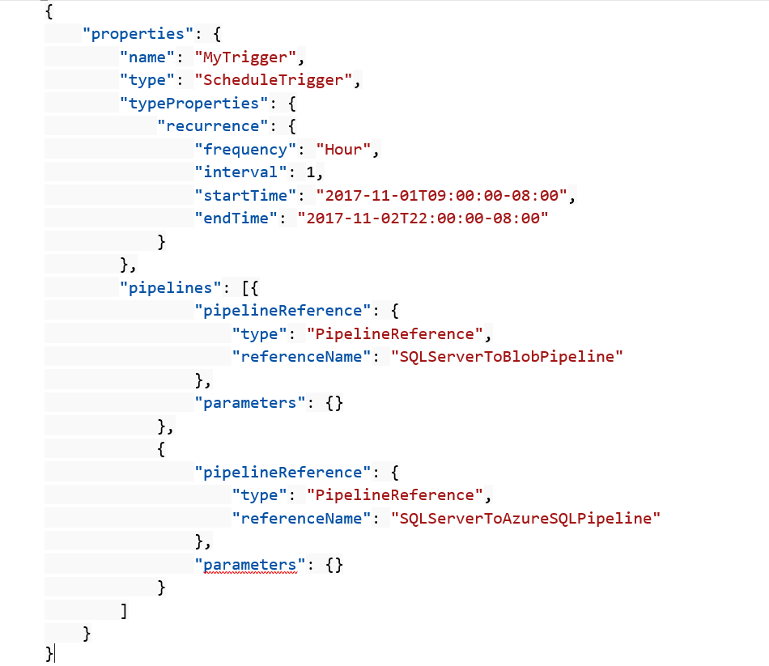
Schedule trigger
A schedule trigger runs pipelines on a wall-clock schedule. This trigger supports periodic and advanced calendar options. For example, the trigger supports intervals like "weekly" or "Monday at 5:00 PM and Thursday at 9:00 PM."

Slide 93
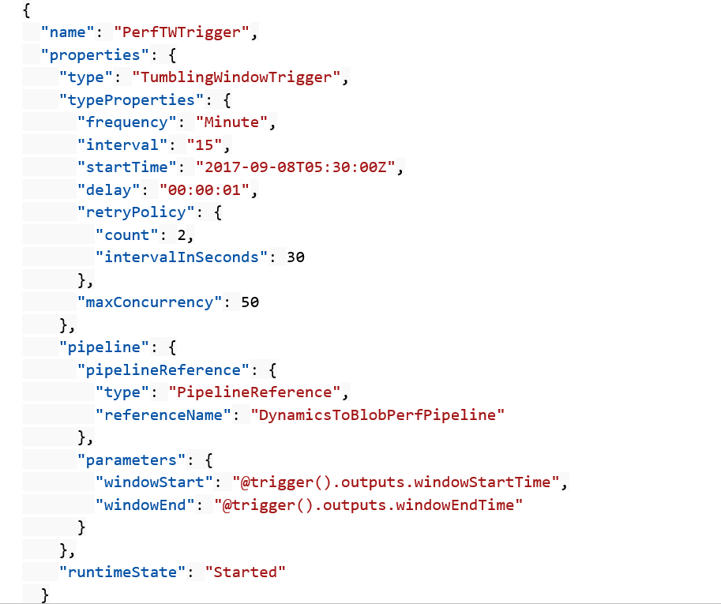
Tumbling window trigger
Tumbling window triggers are a type of trigger that fires at a periodic time interval from a specified start time, while retaining state. Tumbling windows are a series of fixed-sized, non-overlapping, and contiguous time intervals.

Slide 94
Control flow

Slide 95
Control flow
Filter activity
ForEach activity
Get metadata
Execute Pipeline
If Condition activity
Web activity
Lookup activity
Wait activity
Until activity

Slide 96
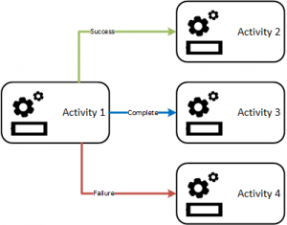
Branching
On success
On failure
On completion
On skip

Slide 97
Hands on Usecase

Slide 98
Usecase
One of the Manufacturing client needs data coming from multiple sources to be automated to generate reports and even send the email at the end.
This should be a one time creation of pipeline but any new source integration should not impact the pipeline process.

Slide 99
Build 2019
Whats New !!!

Slide 111
Future is most promising for ADF
Data Flows are in Public Preview since Build 2019. (Since 1 Week)

Slide 112
Hands on Usecase

Slide 113
Usecase
One of the Manufacturing client needs data coming from multiple sources to be automated to generate reports and even send the email at the end.
This should be a one time creation of pipeline but any new source integration should not impact the pipeline process.

